Slide 1
Threaded Binary Tree
A binary tree in which each node uses an otherwise-empty left child link to refer to the node's in-order predecessor and an empty right child link to refer to its in-Order Successor.
And binary tree with such pointers are called threaded tree.
In the memory representation of a threaded binary tree, it is necessary to distinguish between a normal pointer and a thread.
Slide 1

Slide 2
Structure of Thread BT
Node structure
For the purpose of our evaluation algorithm, we assume each node has five fields:
left | lchild | data | rchild | right
class thread{
bool left;
thread *lchild;
int data;
thread *rchild;
bool right;
};
Slide 12

Slide 3
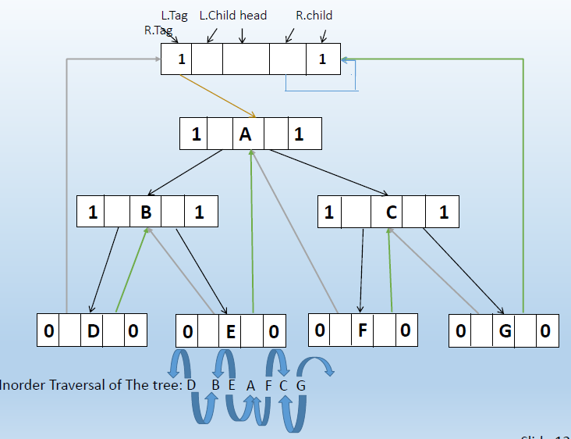

Slide 4
Threaded Tree Traversal
We start at the leftmost node in the tree, print it, and follow its right thread
If we follow a thread to the right, we output the node and continue to its right.
If we follow a link to the right, we go to the leftmost node, print it, and continue.
Slide 14

Slide 5
Threaded Tree Traversal
Output
1
6
8
3
1
5
7
9
Start at leftmost node, print it
Slide 15

Slide 6
Threaded Tree Traversal
Output
1
3
6
8
3
1
5
7
9
Follow thread to right, print node
Slide 16

Slide 7
Threaded Tree Traversal
Output
1
3
5
6
8
3
1
5
7
9
Follow link to right, go to leftmost node and print
Slide 17

Slide 8
Threaded Tree Traversal
Output
1
3
5
6
6
8
3
1
5
7
9
Follow thread to right, print node
Slide 18

Slide 9
Threaded Tree Traversal
Output
1
3
5
6
7
6
8
3
1
5
7
9
Follow link to right, go to leftmost node and print
Slide 19

Slide 10
Threaded Tree Traversal
Output
1
3
5
6
7
8
6
8
3
1
5
7
9
Follow thread to right, print node
Slide 20

Slide 11
Threaded Tree Traversal
Output
1
3
5
6
7
8
9
6
8
3
1
5
7
9
Follow link to right, go to leftmost node and print
Slide 21

Slide 12
class thread
{
bool left;
thread *lchild;
int data;
thread *rchild;
bool right;
public:
void insert(int num);
};

Slide 13
void thread::inorder()
{
thread *p=head->lchild;
while(p!=head)
{
//0 for thread
while(p->left!=0) p=p->lchild;
cout<<p->data<<" ";
while(p->right==0) //rchild is a thread
{
p=p->rchild;
cout<<p->data<<" ";
}
p=p->rchild; //rchild is a link (not thread)
}
}

